Slide 1
Past abilities
09. Used to

Slide 2
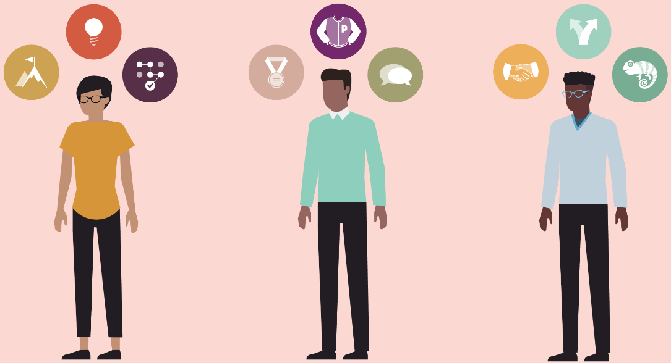
Past abilities
Did you practice sports when you were a child?
Did you have a hobby when you were younger?
Do you have an old habit that you no longer have?

Slide 3
Used to
We use used to + base verb to say that something happened regularly in the past but no longer happens.
I used to work out once a week, but now I work out every day.
Hang out | Look after | Go for | Look forward to
Be into | Get along with | Hand in | Pick up
Put off | Get up | Keep up | Put on
Throw away | Give in | Lie down | Run out
Notes:
Hang out (with) – spend time with
Be into = like
Put off – postpone/delay
Throw away – put in the bin
Look after – take care of
Get along with – be friends with
Get up – rise after waking up, stand up
Give in – surrender
Go for – choose
Hand in – deliver, submit
Keep up – don’t stop, keep the rhythm
Lie down – rest, recline
Look forward to – be excited about something in the future
Pick up – increase, answer the phone, take someone on a vehicle
Put on - wear
Run out – finish, use something until there is nothing left

Slide 4
Complete with used to + verb
study live sit smoke write go eat
My husband ________ a lot, but a year ago he quit smoking.
I ________ a lot of junk food, but now I eat more fresh fruit and vegetables.
Peter ________ in a small apartment, but last month he moved into a large apartment.
Lena ________ on crash diets to lose weight, but now she counts calories instead.
Tom and Susan ________ at City University, but now they go to Columbia University.
I ________ articles about politics for the newspaper, but now I am doing restaurant and theater reviews.
My mother ________ around all day doing nothing. Now she is very busy and has a wonderful new lifestyle.
Notes:
1. used to smoke
2. used to eat
3. used to live
4. used to go
5. used to study
6. used to write
7. used to sit

Slide 5
Used to / Would
Used to can be replaced by Would for actions that happened regularly. It is more formal, and we use it in positive sentences.
I would often play with imaginary friends when I was younger.
*We can’t use Would to talk about states in past. For those cases we must use Used To: I used to be very thin.
Would + bare infinitive = When I was in university I would sleep in.
When I was in university, I would….
Notes:
https://www.youtube.com/watch?v=LLICoX4j7rc

Slide 6
Used to, Would or both?
I ______ be lazy at school.
She ______ have only one dog, now she has 7.
On sunny days, we ______ go to the beach.
___ you ___ have a lot of friends at school?
They ______ play sports all afternoon.
When I was a baby, my mom ______ let me play with her makeup.
We ______ live in the country side, then we moved to the city.
I ______ wear glasses, and now I do.
I ______ eat a lot of sweets, which brought me a lot of dental issues.
My dad ______ tell us stories about his childhood.
Notes:
Would is for actions.
I used to be lazy at school.
She used to have only one dog, now she has 7.
On sunny days, we would go to the beach.
Did you use to have a lot of friends at school?
They would play sports all afternoon.
When I was a baby, my mom would let me play with her makeup.
We used to live in the country side, then we moved to the city.
I didn’t use to wear glasses, and now I do.
I would eat a lot of sweets, which brought me a lot of dental issues.
My dad would tell us stories about his childhood.

Slide 7
Be used to
We use this expression to say that we are accustomed to something, and this thing is no longer new or strange (can be expressed in all tenses).
(+) be used to + noun / gerund = I was used to working from home.
(-) be + not + used to + noun / gerund = You weren’t used to cooking every day.
(?) be + subject+ used to + noun / gerund = Are they used to their new office?
What weren’t you used to doing before working from home?
Notes:
I am used to sleeping late on the weekend.
He’s not used to his new home yet.
I was used to dancing every day and didn’t want to give it up.

Slide 8
Complete the sentences
I ___ used to waking up early. (present)
She ___ used to living in a big city. (present)
Jane and Daniel ___ used to talking English until they practice a lot. (future, negative)
They ___ used to working long hours. (past, negative)
We ___ used to the noise of traffic outside our window. (present)
He ___ used to spicy food, but now he is. (past, negative)
___ you used to driving on the right side of the road? (present)
Now we ___ used to public speaking. (present)
They ___ used to such hot temperatures. (present, negative)
We ___ used to a different time zone when we travel. (future)
Notes:
I am used to waking up early.
She is used to living in a big city.
Jane and Daniel will not be used to talking English until they practice a lot.
They were not used to working long hours.
We are used to the noise of traffic outside our window.
He was not used to spicy food, but now he is.
Are you used to driving on the right side of the road?
Now we are used to public speaking.
They are not used to such hot temperatures.
We will be used to a different time zone when we travel.

Slide 9
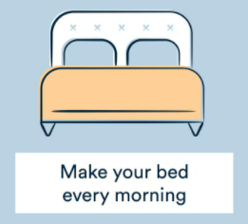
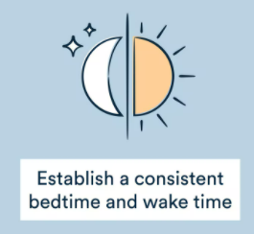

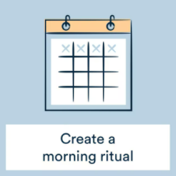
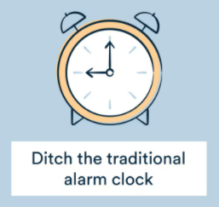
Get used to
We use this to express the process of becoming accustomed to something (can be expressed in all tenses).
get used to + noun / gerund = I am getting used to going to bed early.
What do you want to get in your routine?
Notes:
David is getting used to his new school.
We quickly got used to life in the country.
I can’t get used to studying all day.

Slide 10
How have you changed?
Think about past abilities or things that have changed in your life.
Write them and share with the class.
Write one in the chat.
Notes:
Practice kahoot
https://create.kahoot.it/details/3c3a1b51-297d-4bcd-b02b-2dd7c280f5e7

